Slide 1
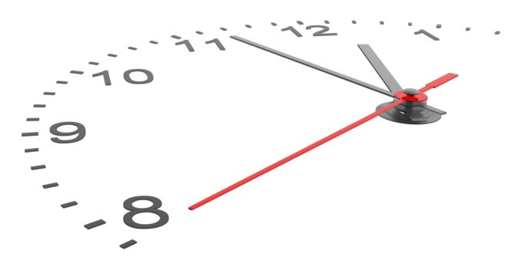
The Evolution of Timekeeping
Jerry (Yuanjie) Zhao

Slide 2

Imagine you are Robinson Crusoe…
How do you keep track of time?

Slide 3
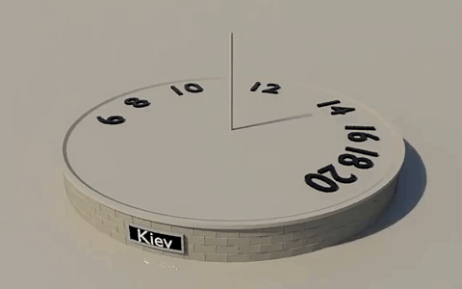
Sundial
Use the shadow of a stick to keep time

Slide 4
Problem: not working at night

Slide 5
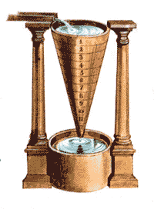
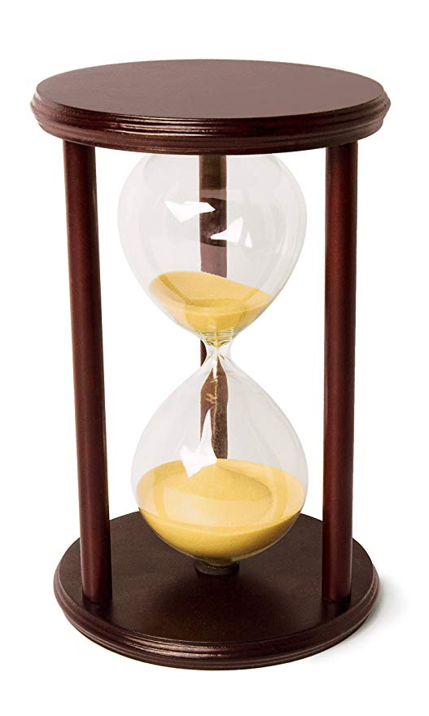
Water clock & Hour glass

Slide 6
Problem: less accurate than sundial
Less accurate & stable than sundial in long term
water clock: hard to keep water drip at a constant rate
hour glass: need human to flip hour glass and count the hours
Extra Problems of sundial
Max accuracy is minute, no way to subdivide minute in a sundial
Length of an hour changes over seasons
An hour in the summer is much longer than in the winter

Slide 7
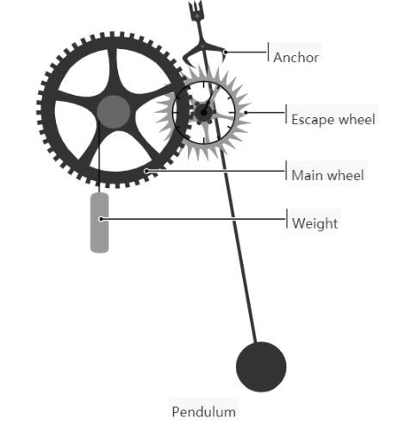
Mechanical clock (pendulum)
Escapement controls transfer of energy from power source to the counting mechanism.
Animation

Slide 8

Problem: unreliable on boat
violent motion of sea, variations in gravity at different latitudes

Slide 9
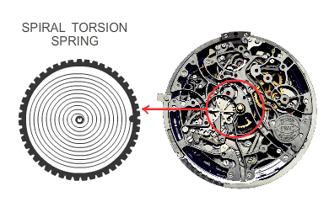
Mechanical clock (coiled spring)
Use spring to regulates the rotary oscillation of main wheel
video

Slide 10
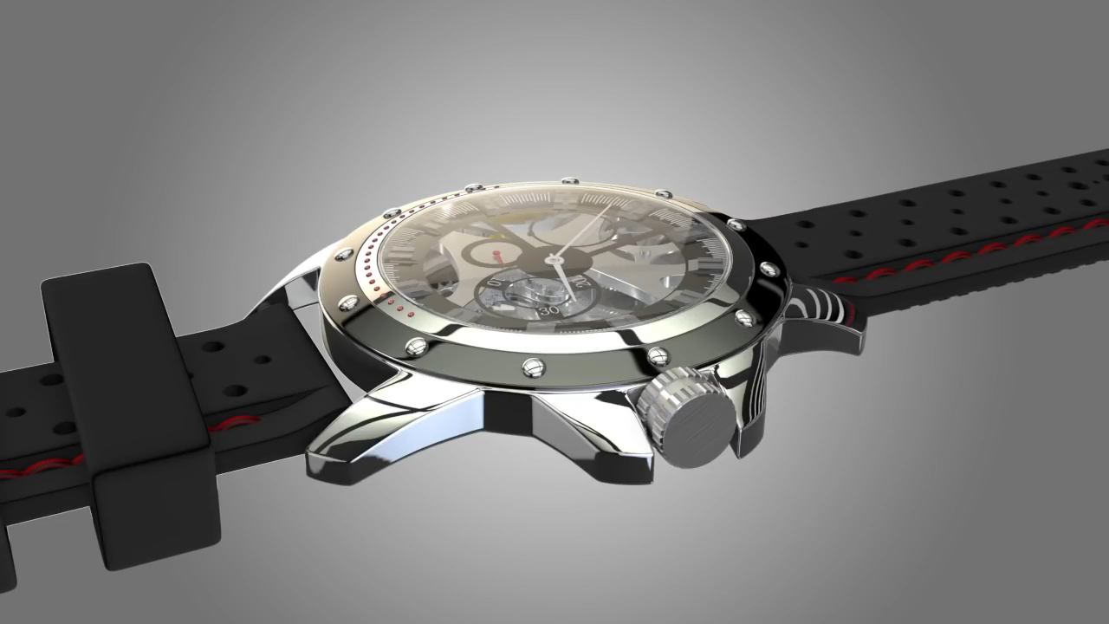

Slide 11
Problem: not accurate for scientists
Need more accurate clock for experiments like measuring speed of light

Slide 12
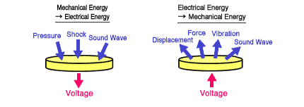
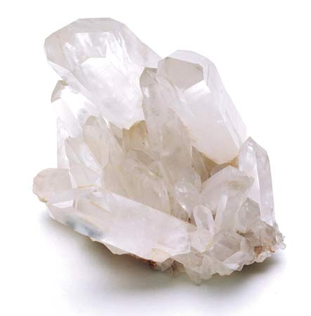
Quartz Clock
Piezoelectric effect

Slide 13
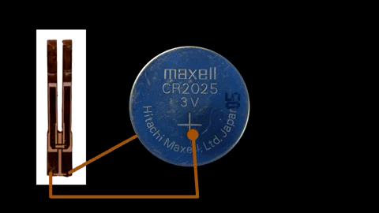
Quartz Clock

Slide 14
Quartz Clock
The crystal is designed to oscillate at 32,768 Hz (2¹⁵ = 32768).
Each time a 16-bit counter reaches 32,768, it sends an output and you get a second

Slide 15
Problem: still not stable enough
Different crystals resonate at slightly different frequency.
Resonant frequency depends on temperature.
Typical quartz crystal clocks drift 1.73 seconds per day.

Slide 16
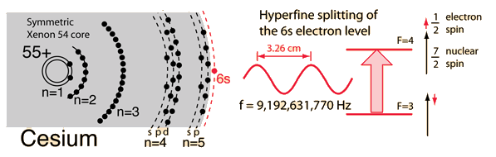
Atomic Clock
Transition between energy states emits radiation at definite frequency.
All atoms resonate at extremely consistent frequencies

Slide 17
Atomic Clock
Cesium clock drifts 8.46ns per day.
1 second = 9,192,631,770 cycles of a Cesium atomic clock

Slide 18
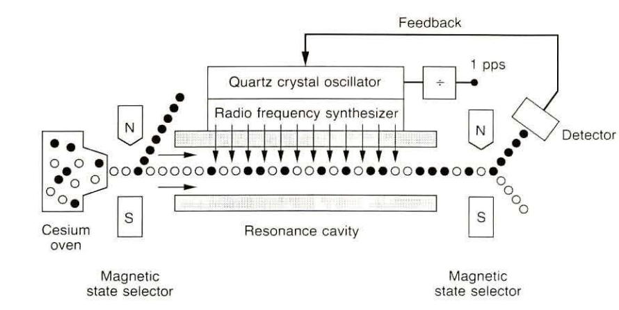
Appendix: How atomic clock works

Slide 19
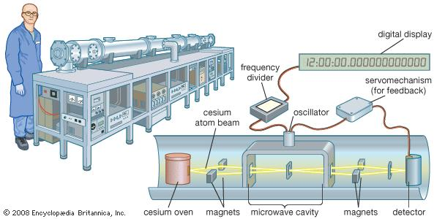
Appendix: How atomic clock works

Slide 20
Future Investigations
Can we build a clock that drifts less than 1s for the entire lifespan of our universe?
How to accurately transfer time between such precise clocks?

Slide 21
Reference
1. Hinkley, N., Sherman, J. A., Phillips, N. B., Schioppo, M., Lemke, N. D., Beloy, K., ... & Ludlow, A. D. (2013). An atomic clock with 10− 18 instability. Science, 1240420.
2. Ives, H. E., & Stilwell, G. R. (1938). An experimental study of the rate of a moving atomic clock. JOSA, 28(7), 215-226.
3. Wikipedia contributors. (2018, September 27). History of timekeeping devices. In Wikipedia, The Free Encyclopedia. Retrieved 16:44, October 11, 2018, from
https://en.wikipedia.org/w/index.php?title=History_of_timekeeping_devices&oldid=861475382
4. Wikipedia contributors. (2018, September 29). Standard time. In Wikipedia, The Free Encyclopedia. Retrieved 07:00, October 11, 2018, from
https://en.wikipedia.org/w/index.php?title=Standard_time&oldid=861687315
5. Lewandowski, W., Azoubib, J., & Klepczynski, W. J. (1999). GPS: primary tool for time transfer. Proceedings of the IEEE, 87(1), 163-172.
6. Wikipedia contributors. (2018, October 2). Time zone. In Wikipedia, The Free Encyclopedia. Retrieved 07:01, October 11, 2018, from
https://en.wikipedia.org/w/index.php?title=Time_zone&oldid=862212990
7. Alvele, B. (2018). Time Standards. Retrieved from
http://www.exactlywhatistime.com/measurement-of-time/time-standards/

Slide 22
Reference
Image
https://hibiscusmooncrystalacademy.com/wp-content/uploads/2015/06/piezo.png
http://hyperphysics.phy-astr.gsu.edu/hbase/images/Csclock.gif
https://1.bp.blogspot.com/-3od_KZWyuYo/WKKgB9hWcEI/AAAAAAAABEg/8Y0XT_PJBAIRKkM1rbTzABKRF-rg8VoTwCLcB/s1600/piezoelectric-transducer.PNG
https://www.edumedia-sciences.com/en/media/767-mechanical-clock
https://static.makeuseof.com/wp-content/uploads/2013/04/time-clock-670x335.jpg
Video
https://www.youtube.com/watch?v=1pM6uD8nePo

Slide 23
QA

